Slide 1
Layout titolo
Sottotitolo

Slide 3
What we wanted it to be:
Something that actually moves around without catching fire
(it actually catched fire at some point)
Something that can be controlled remotely
Something that somehow perceives it’s proximities

Slide 4
CM-01 Automatic Car
What we wanted it to be:
What we achieved:
Something that actually moves around without catching fire
(it actually catched fire at some point)
Something that can be controlled remotely
Something that somehow perceives it’s proximities
Mobility: 4 wheels, controlled in pairs
Remote Control:
Wifi: using ESP8266
Infrared remote
Proximity sensing:
HCSR04 ultrasonic range sensor + servo for scanning at 180°
IR range sensor for line following

Slide 5
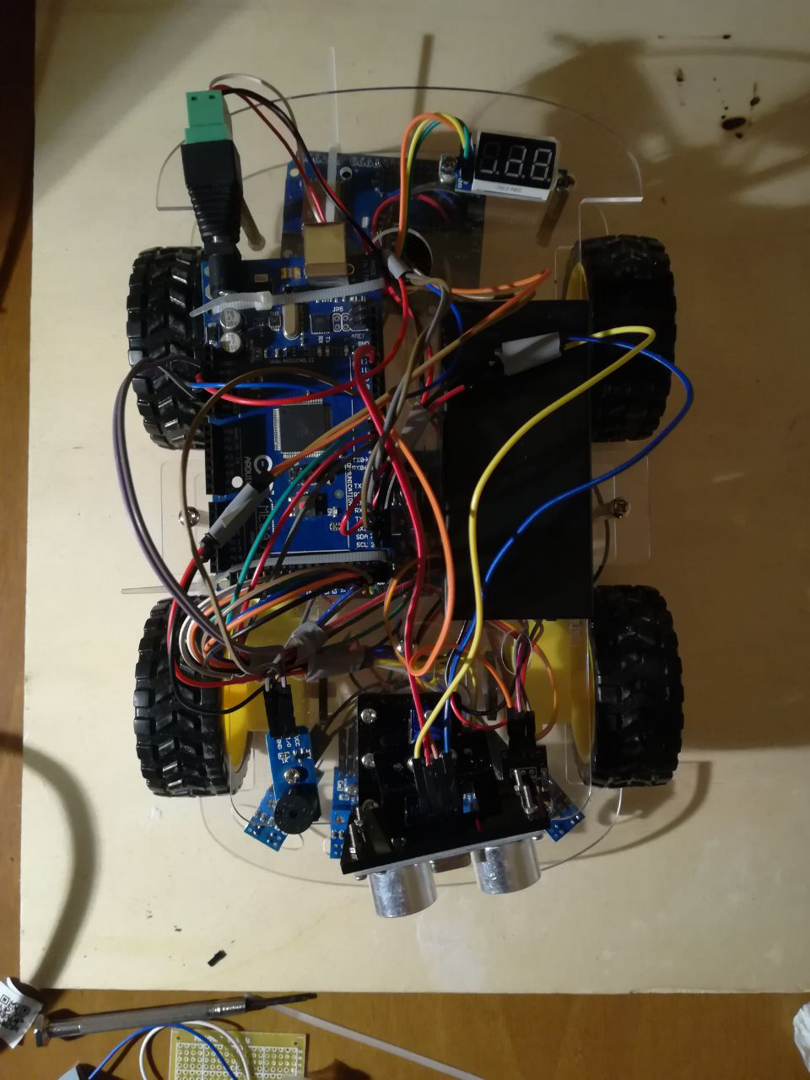
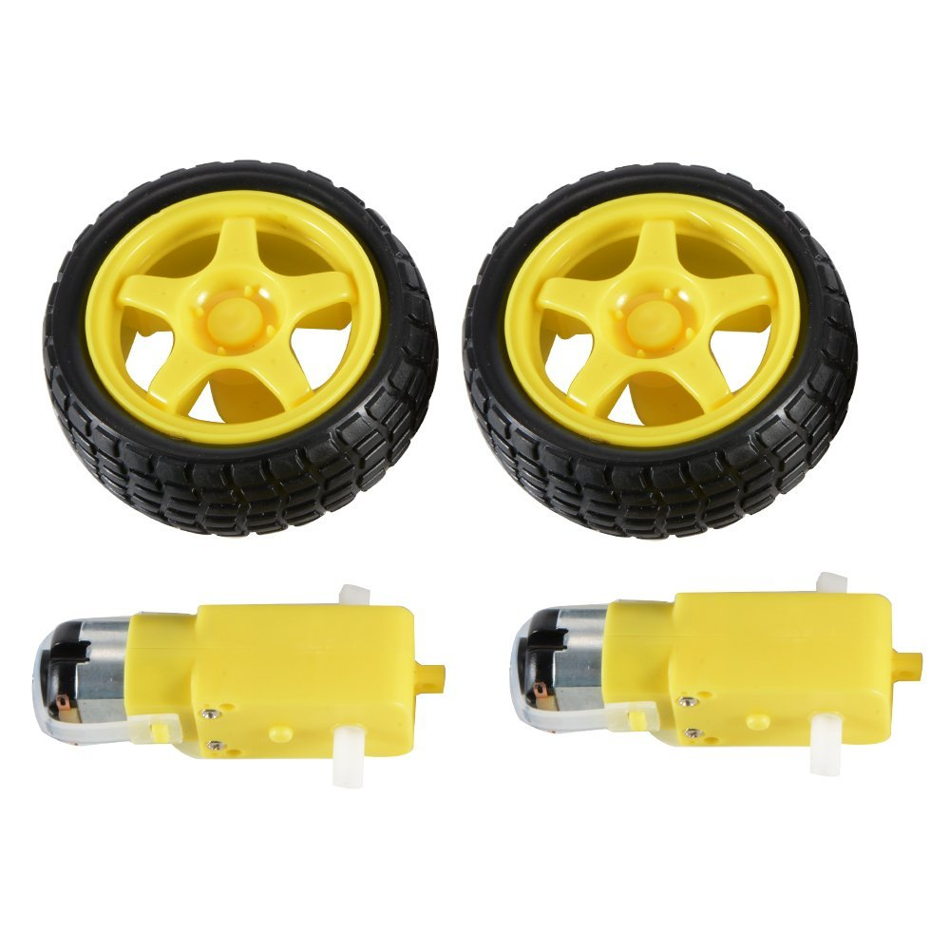
Components:
DC motors + Wheels:
Sold in couples, 5 euros on Amazon, much less on Aliexpress.
Rated 3V – 6V

Slide 6
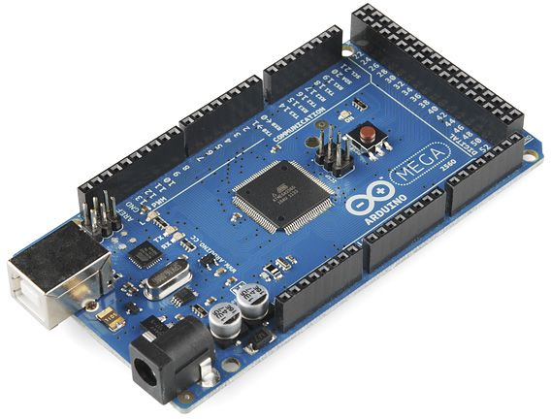
Components:
Arduino Mega 2560 REV3
Has LOTS of GPIO pins, PWM-enabled pins and Analog pins
Multiple Serial interfaces
Same layout of Arduino Uno for shield compatibility

Slide 7
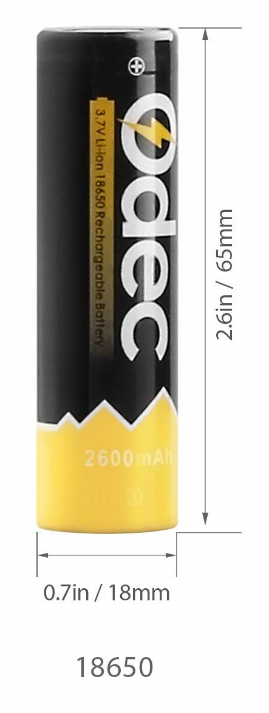
Components:
2x 18650 Li-ion cells
3.6V each (actually almost 4V when fully charged)
!!Faulty battery socket can make them catch fire!!
But as long as you’re careful it should be ok

Slide 8
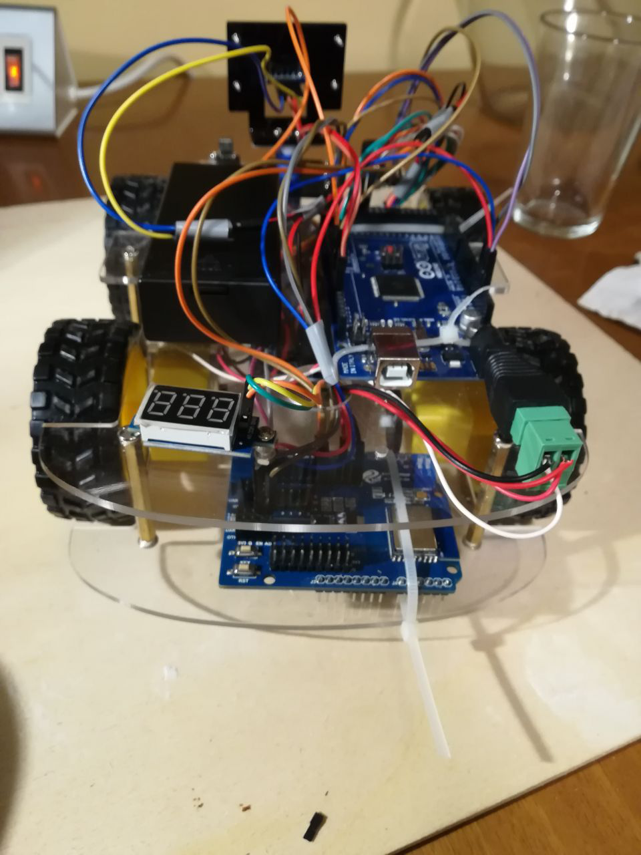
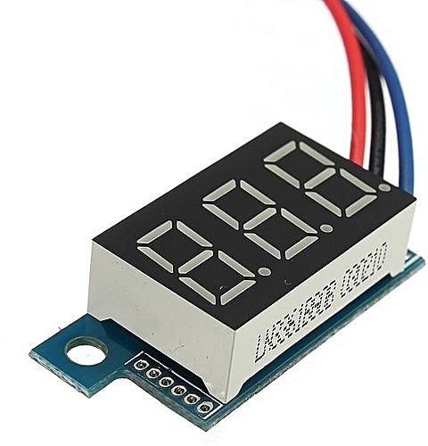
Components:
Voltage meter:
Small
Not very accurate but it’s used only for battery charge status estimation

Slide 9
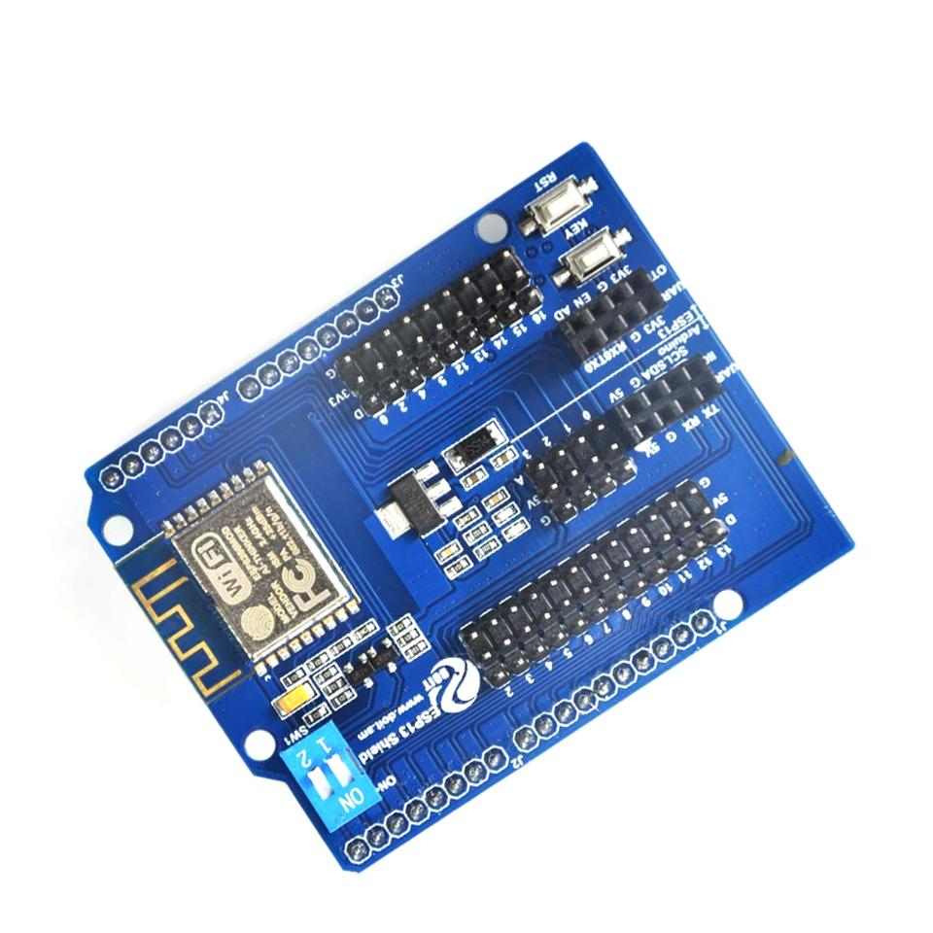
Components:
ESP-13 shield
Carries an ESP-WROOM-02 module based on ESP8266
Not mounted as a shield (going to see why soon)
Cheap compared to other ESP8266 shields
Turns out there’s a reason for that

Slide 10
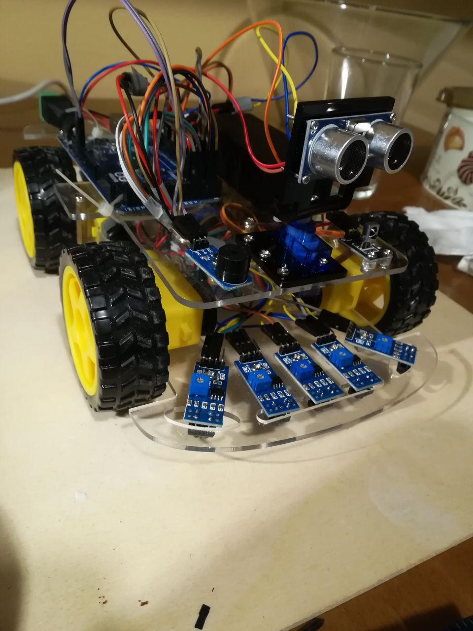
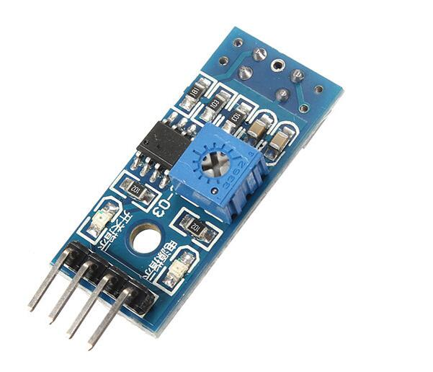
Components:
5X IR proximity sensing modules
Contains an LML393 comparator by ON Semiconductor coupled with a TRT5000 sensor by Vishay
Functioning explained later
Used to let the car follow a black line on the terrain

Slide 11
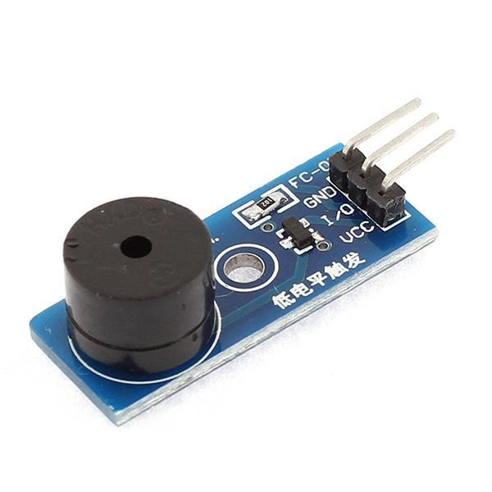
Components:
Piezo Active Buzzer Module
Rated for 3.3V-5V (transistor onboard for power mode switching)
Different from passive buzzer:
Can generate a fixed tone when I/O is HIGH (3.3V)
Con: no frequency control
Pro: doesn’t require a pre-generated waveform

Slide 12
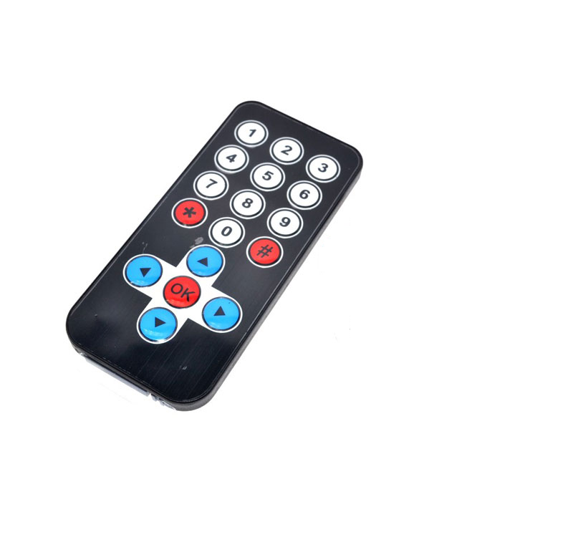
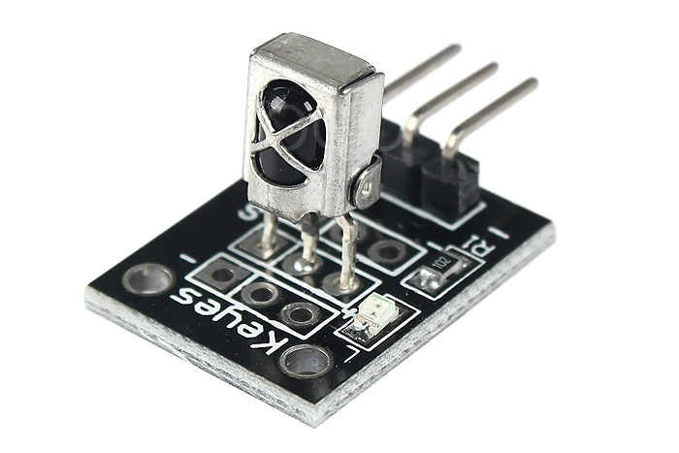
Components:
IR receiver module
Basically a TL1838 Infrared Receiver mounted on a pcb + LED to signal incoming IR message
Allows car to receive signals from any el-cheapo IR transmitter or remote control

Slide 13
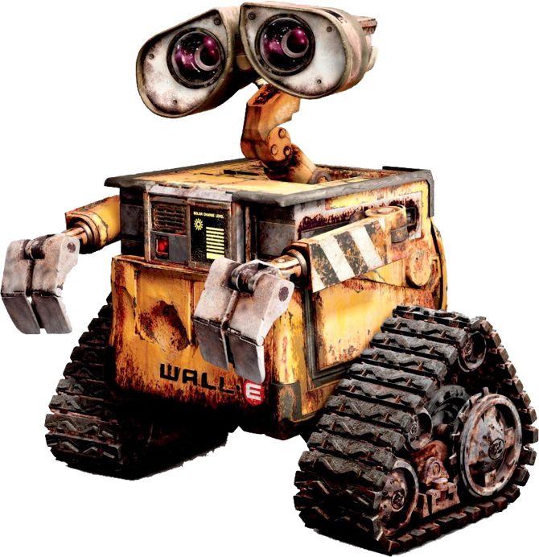
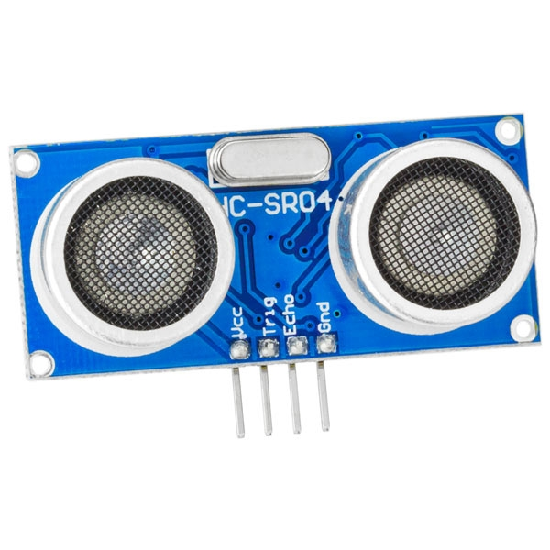
Components:
HCSR04 Ultrasonic Ranging Module:
A couple of transducers, one for transmitting and one for receiving are used to measure an echo delay, thus estimating a linear distance from the sensor itself.
Mounted on a rotating support ot scan multiple directions
Kinda makes the whole thing look like Wall-E

Slide 14
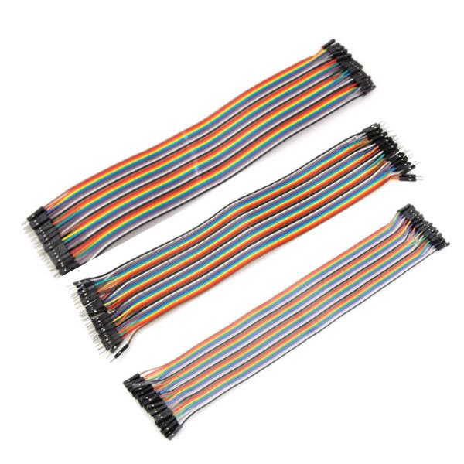
Components:
Jumper Wires
Everything is connected using jumper wires:
MtF
MtM
FtF

Slide 15
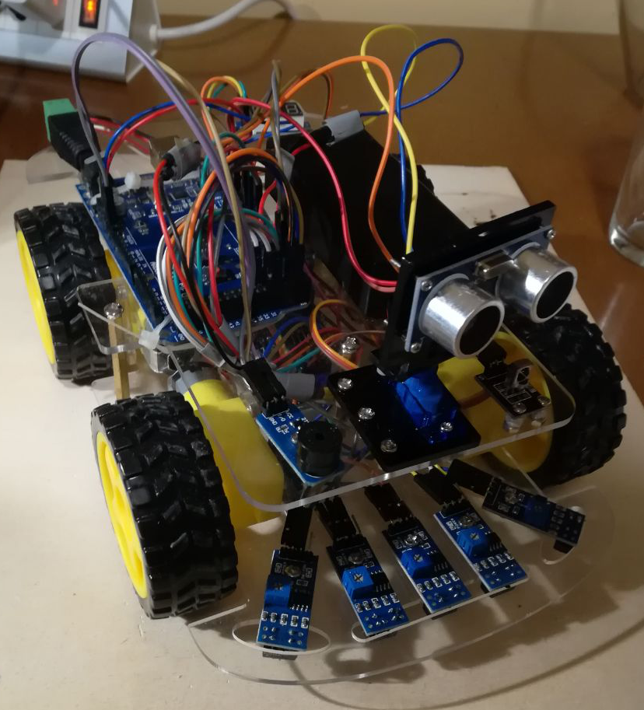
Components:
Piezo Active Buzzer Module
Rated for 3.3V-5V (transistor onboard for power mode switching)
Different from

Slide 16
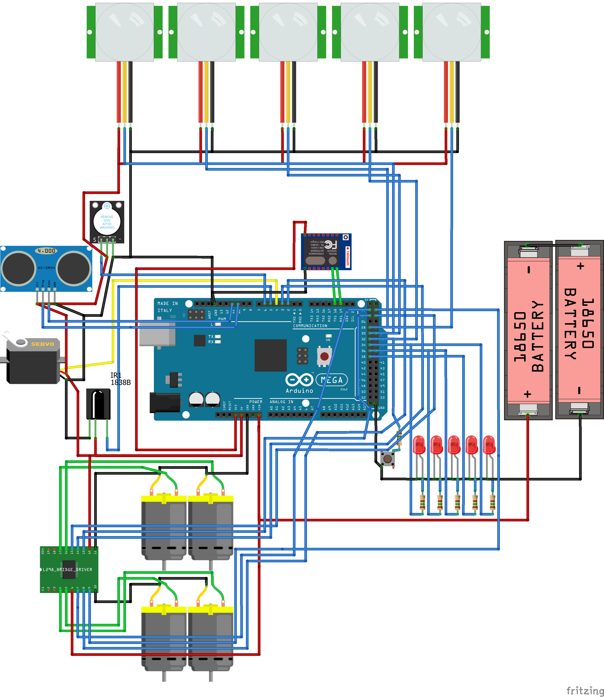
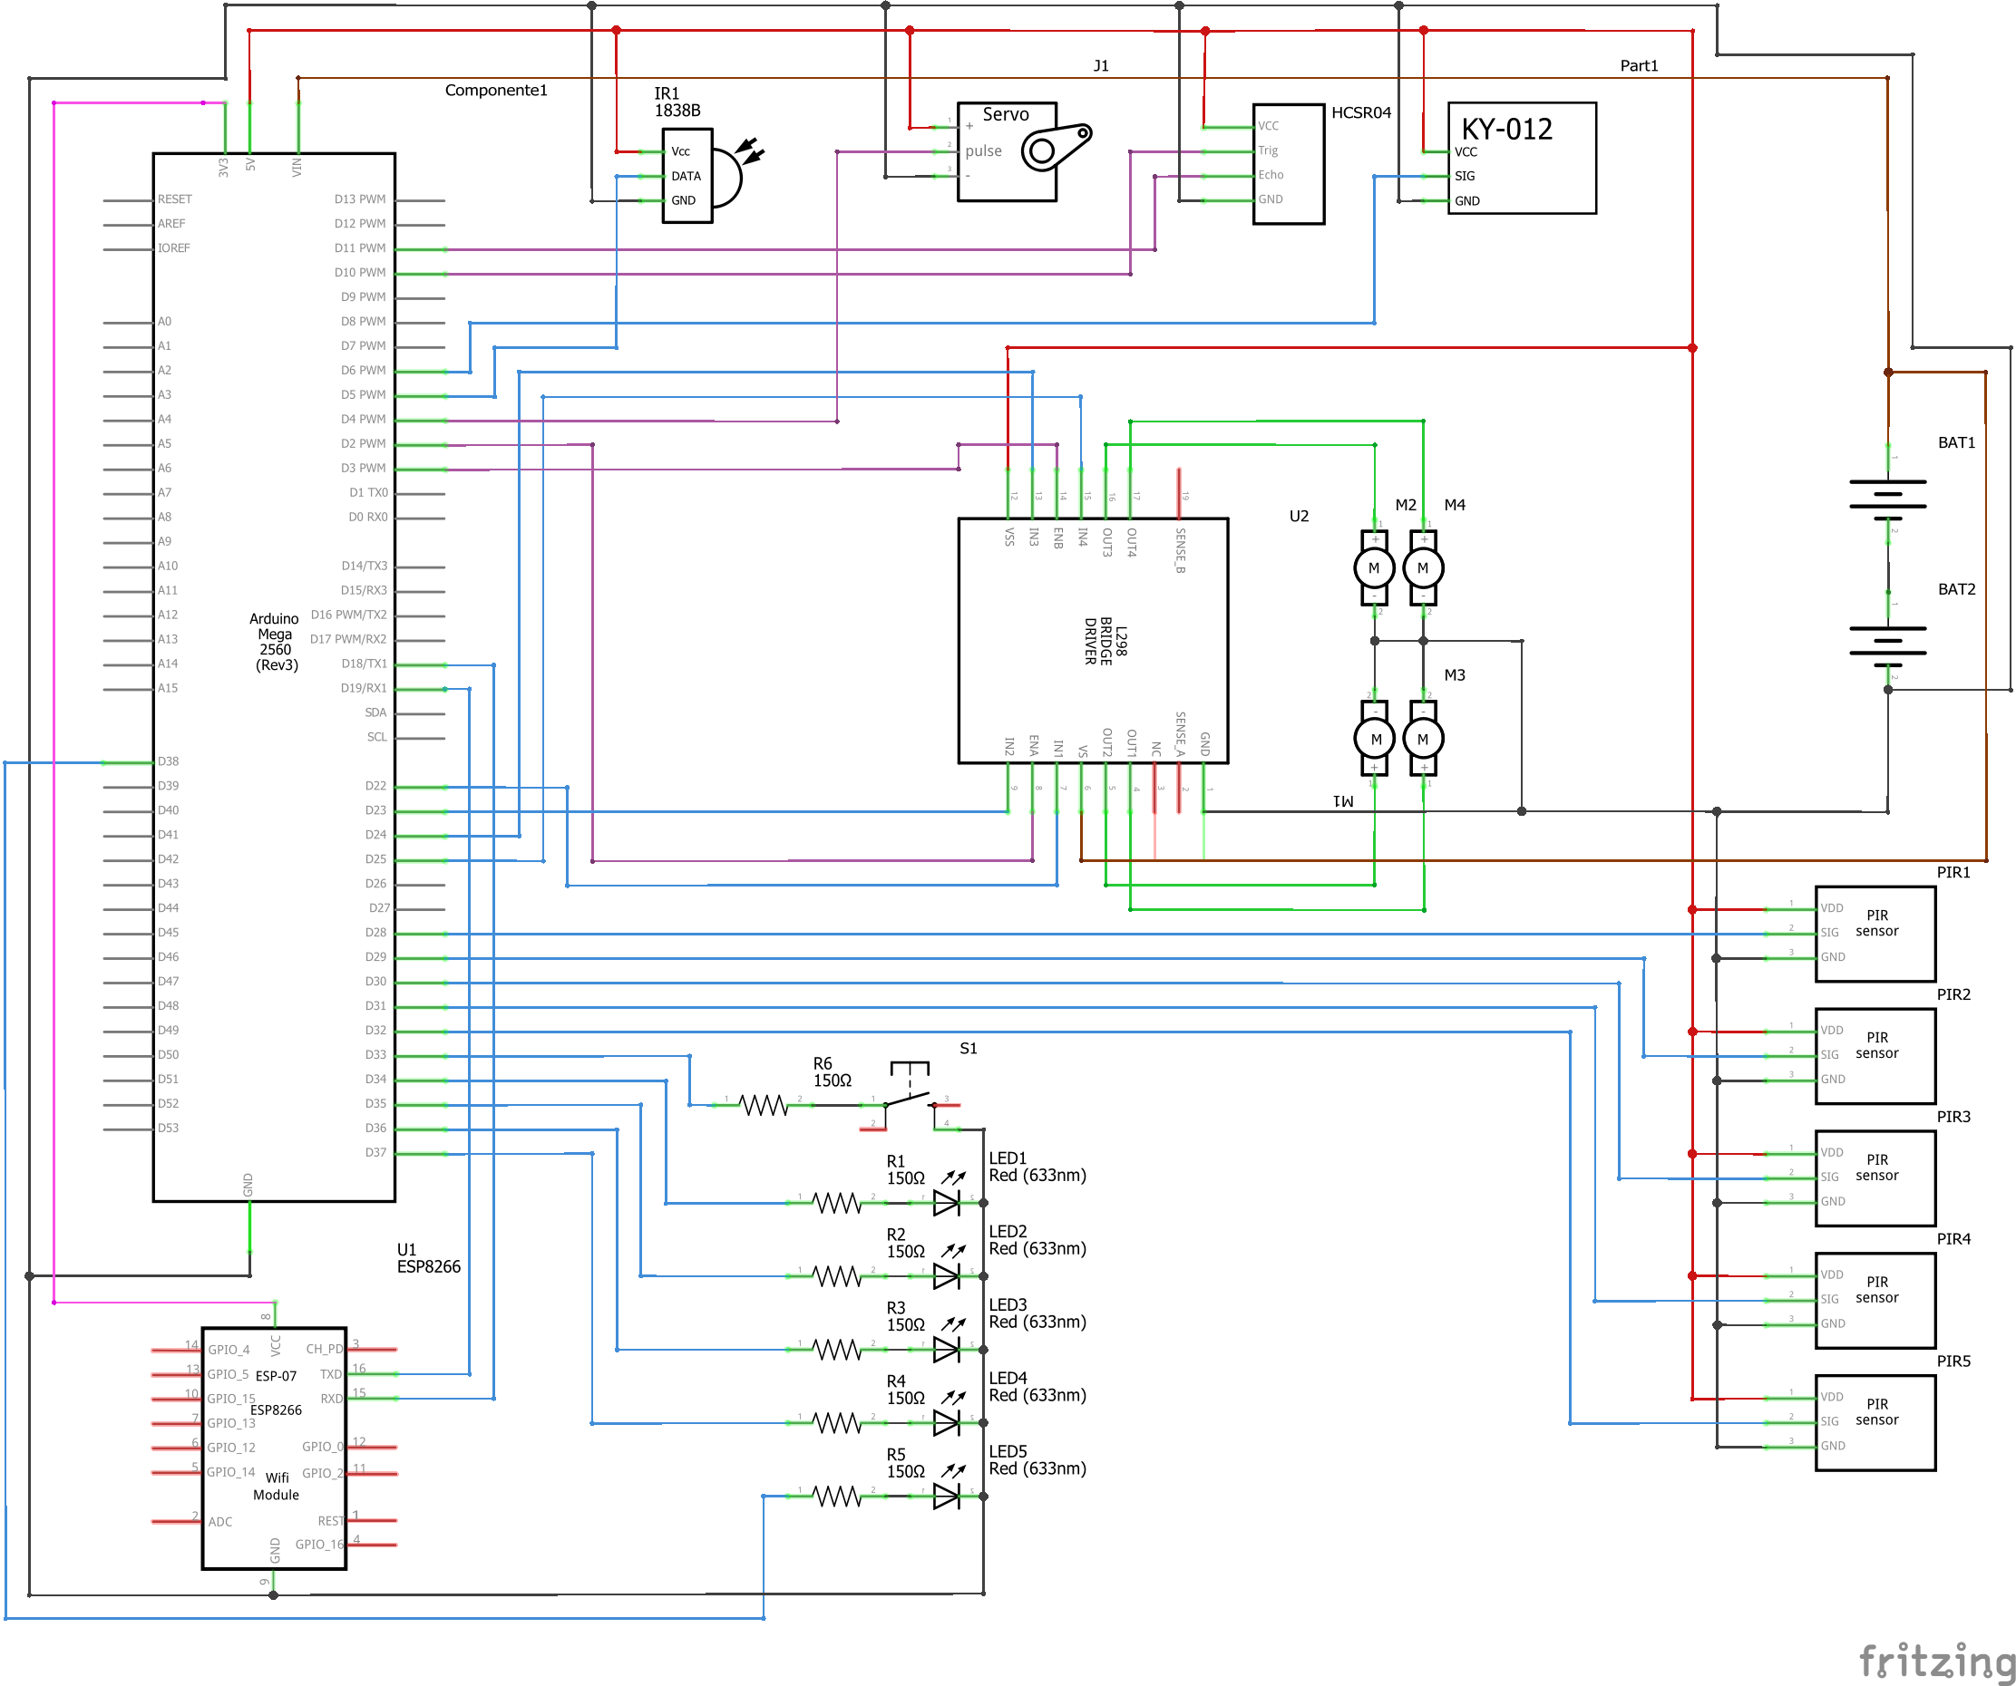
Schematics

Slide 17
Putting everything together:
The ESP shield

Slide 18
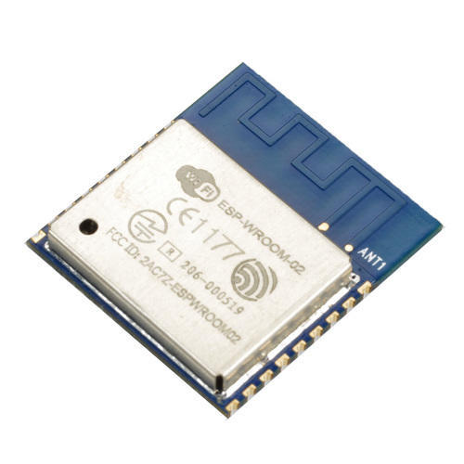
The ESP shield
The ESP-13 is an Arduino Uno shield whith an embedded ESP-WROOM02 module.
The ESP-WROOM02 by Espressif is an integrated WiFi 802.11 b/g/n module designed for providing wireless connection to embedded systems, it’s powered by an ESP8266EX chip, a 32 bit low-power microcontroller, with 2MB of onboard memory and can be programmed with the Arduino IDE.
ESP-13 by Jaycar offers a breakout for all the pins of the ESP-WROOM02, an onboard voltage divider for powering the ESP-WROOM02 itself (Arduino offers a 5V line but ESP8266 uses 3.3V signals both for powering and GPIO communication) and a level shifter for the logic signals coming from and to the Arduino.
Or at least it should…

Slide 19
Layout titolo e contenuto con grafico

Slide 20
Layout due contenuti con tabella
Primo punto elenco qui
Secondo punto elenco qui
Terzo punto elenco qui
Classe | Gruppo 1 | Gruppo 2
Classe 1 | 82 | 95
Classe 2 | 76 | 88
Classe 3 | 84 | 90

Slide 21
Layout titolo e contenuto con SmartArt
Titolo fase 1
Descrizione attività
Titolo fase 2
Descrizione attività
Titolo fase 3
Descrizione attività

Slide 22
Aggiungere un titolo di diapositiva - 1

Slide 23
Aggiungere un titolo di diapositiva - 2

Slide 24
Aggiungere un titolo di diapositiva - 3

Slide 26
Aggiungere un titolo di diapositiva - 4

Slide 27
Aggiungere un titolo di diapositiva - 5

